Slide 1

Collimator assembly operation labor reduction
PowerSteering #:LEAN-1701
Project Belt Leader: {Zhiwei Yang, Lean Belt}
Project Champion: {Jun Liang}
Division: {DSS}
Project Location: {Oplink Zhuhai, MFG, WS1}
Project Completion Date: {Mar 30th 2017}

Slide 2
DEFINE Phase

Slide 3
Team Members
Project Champion: Process Owner:
<Jun Liang> <Zhiwei Yang>
Core Team Members:
< Lili Liao, Passive MFG, Foreman >
< Hou Zhan, Passive MFG, Engineer >
< Dongdong Qi, Passive MFG, Engineer >
< Xinhua, Zhou, Passive MFG, Engineer >
Ad Hoc Team Members or SME’s:
< Jian Li, Finance department, Manager >
3
Notes:
Include the Project Champion, the Process Owner and all active team members.
If a fellow BB is assisting with the project AS A BLACK BELT, then they should be identified as such, however, if a fellow BB is assisting as a team member, then identify them as a team member here and on the Project Tracking System.

Slide 4
Objective / Goal Statement: – CTQ (specific & measurable)
Problem Statement:
In the first half of 2016, the increase of collimator assembly operation labor is becoming the bottleneck during the improving production period; The average operation labor is 7.94min/pcs, it‘s in urgent need of optimizing and reducing labor.
Reducing the whole assembly operation labor from 7.94min/pcs to 5.56min/pcs before 2017-3-30.
Notes:
There are three required outcomes to the define phase:
identified customers and their CTQs - Critical to Quality
defined project scope and team charter
mapped the process to be improved
To this end, a problem statement is needed. This problem statement should contain:
A specific statement of the problem being addressed
Descriptive statements outlining locations and/or occurrences of problematic events
Initial “scope of the problem” statement
Defined problem defect (very important)
The Six-Sigma methodology uses a systematic approach to reducing DEFECTS which affect the customer.
Since Six-Sigma focuses on reducing defects, it is necessary that each project definition clearly specifies the defect(s) that will be reduced.

Slide 5
Project Charter
Business Case / Expected Benefits The capacity of Collimator promotion from 2800pcs/day to 5000pcs/day during April to October, 2016, more and more people are needed in the promotion, and the assembly operation is the most consuming of people upon the entire Collimator line; The assembly operation labor and requirement of employee is comparatively high that make a long training duration, which directly affect the promotion feet and Collimator manpower costs, after the discussion of foreman and engineers, reducing the assembly operation labor through a series of spot optimization.

Slide 6
Project Charter
Business Case / Expected Benefits The Expected Benefits is $18,653 as of the last 12 months.
Operational Strategic Impact It’s a part of Collimator line operation labor reduction.
Scope In Scope: All Product of Collimator Line Out of Scope: NA
Consequential Metrics NA

Slide 7
Project Plan Timing
Start | 12-1-2016 | 12-6-2016 | 12-17-2016 | 1-11-2017 | 2-18-2017
Complete | 12-5-2016 | 12-16-2016 | 1-10-2017 | 2-17-2017 | 3-1-2017
D
M
A
I
C

Slide 8
Operational Definition of Key Terms
Key Term 1 – Definition NA

Slide 9
Voice of the Customer
Customer | Voice of Customer | Key Issue | CTQ (the Y)
Supply Chain Planners | Accomplish the throughput promotion of Collimator line | Improve the throughput | Reduce the assembly operation labor of collimator line
Collimator line’s foreman | Add more people, shorten the training duration and optimizing the operation technology | Need more manpower, shorten training time and optimization
Product Manager | Improve employee’s productive efficiency | Improve efficiency

Slide 10
High Level Process Map (SIPOC)
SUPPLIER | INPUT (use nouns) | PROCESS (use verbs) | OUTPUT (use nouns) | CUSTOMER
Coating line, materials and supplies | Lens, 99.8% alcohol and microscope | Clip lens and check cleanliness | Clean lens | Collimator assemble line
collimator assemble line | Glue, tube and clean lens | Put some glue and assemble tube | Lens assembly | Assemble lens operation
Assemble lens operation | UV-light device and lens assembly | Expose to UV-light | Comparatively stationary lens assembly | Baking operation
Baking operation | Comparatively stationary lens | Baking | Stationary lens assembly | Assemble pigtail operation
Pigtail line and baking operation | Pigtail, 99.8% alcohol, nitrogen and stationary assembly | Clean lens and pigtail | The clean lens and pigtail | Assemble pigtail operation
Assemble pigtail operation | The clean lens and pigtail | Assemble pigtail | The collimator assembly | Assemble pigtail operation
Assemble pigtail operation | The collimator assembly | Mark black point | The collimator assembly | Collimator adjust line

Slide 11
MEASURE Phase

Slide 12
Plan for Data Collection
Question to be answered:
MEASURE | DEFINITION | WHO | WHERE | SAMPLING PLAN OR QUANTITY
Training time | Op class and Operator number | Lili, Liao | CIS system, MES system | 2016-12-1~12-9
The throughput | The throughput of assembly operation | Lili, Liao | CIS system, MES system | 2016-12-1~12-9
The procedure take time | The procedure take time of assembling lens | Xinhua, Zhou | Collimator line | 5pcs
VSM | CCD process Beam scan process | Xinhua, Zhou | Collimator line | 2016-12-1~12-30
layout | material flow | Xinhua, Zhou | Collimator line | 2016-12-1~12-30

Slide 13
Stakeholder Analysis
Stakeholder | Very against | Against | neutral | Agree | Very agree
Assembly operation employee |  |  |  |  | √
Collimator line monitor |  |  |  |  | √
Collimator line foreman |  |  |  |  | √
Process engineer |  |  |  |  | √
Process manager |  |  |  |  | √
Product manager |  |  |  |  | √

Slide 14
Confirmed Primary Metric Baseline

Slide 15
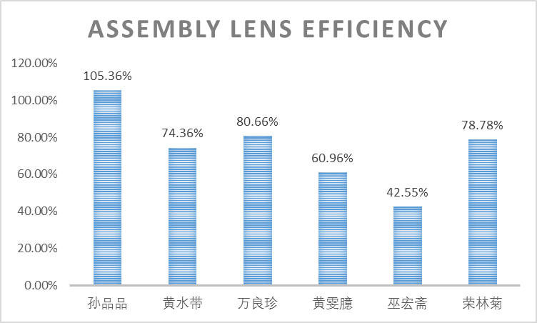
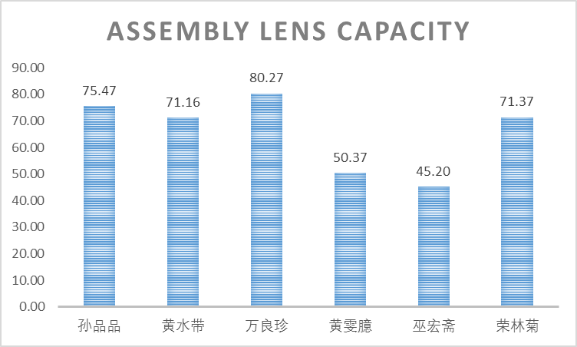
Validate Measurement System
Current situation

Slide 16
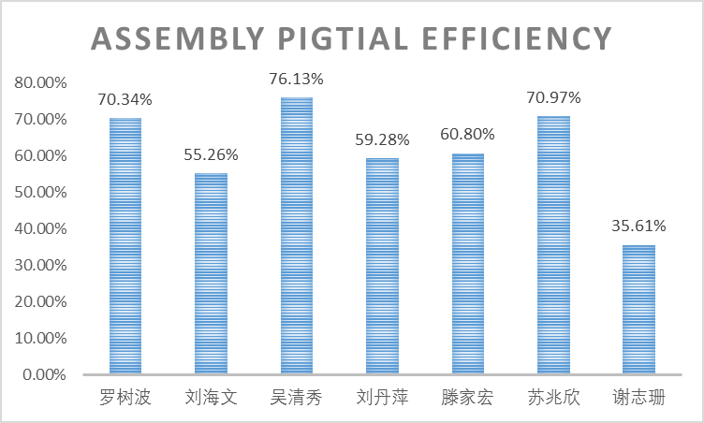
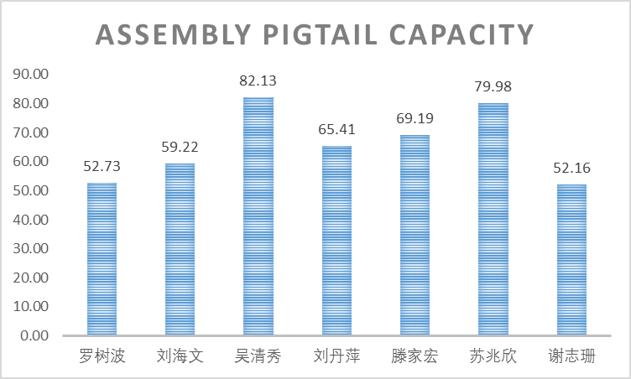
Validate Measurement System
Current situation

Slide 17
The procedure take time

Slide 18
The procedure take time

Slide 19
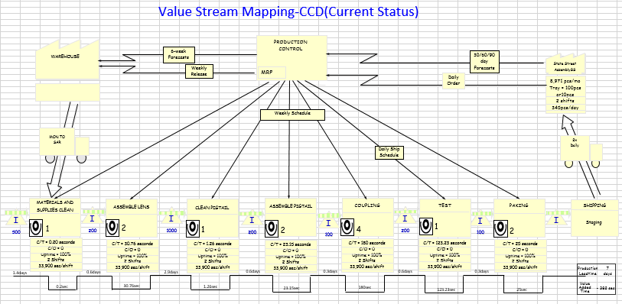
Current State VSM

Slide 20
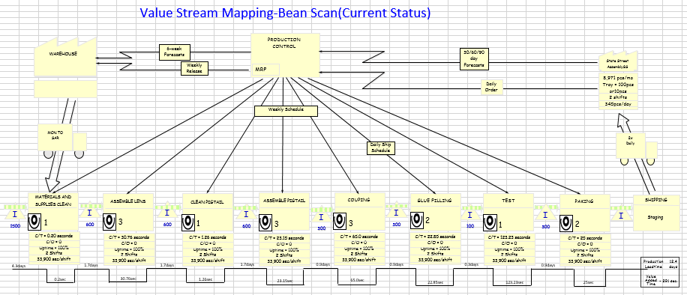
Current State VSM

Slide 21
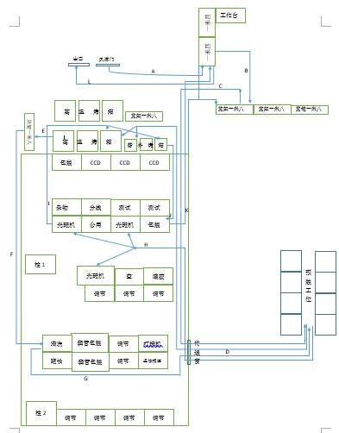
Spaghetti Diagram (Before)

Slide 22
Implement 6S – S1-S3
S1 Sort
Identify unneeded items
S2 Set In Order
Thoroughly organize items in the workplace
S3 Sweep & Shine
Make a plan to keep the area swept and shined

Slide 23
Initial Financial / FTE Benefit Forecast
Note: Financial and FTE Benefit Forecast should also be updated in the Project Benefit Summary area in PowerSteering.
1.Optimize assembly operation labor from 7.94min/pcs to 5.559min/pcs.
2.Potential benefit is about $18,653 all year.

Slide 24
ANALYZE Phase

Slide 25
Analyze Current State Process – FLOW
The yellow columns rate is: (4.93+1.14)/29.03*100%=20.91%
Or (3.79+1.14)/26.42*100%=18.66%

Slide 26
Analyze Current State Process – FLOW
The yellow columns rate is: (4.48+1.07)/31.76*100%=17.47%
Or (3.31+1.07)/30.47*100%=14.37%

Slide 27
Analyze Current State Process – FLOW
Analyze The lens is clean when in coating, but the transportation would make it dirty with plastic box, so in assemble operation, the operator waste time to clean it with alcohol. The rate about waste is 17.85%(average), the efficiency will increase a lot if we can optimize it.

Slide 28
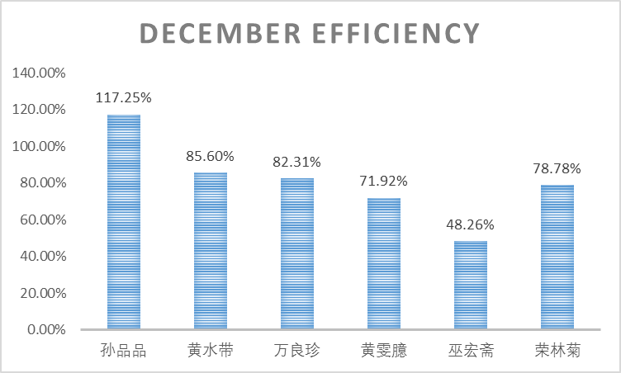
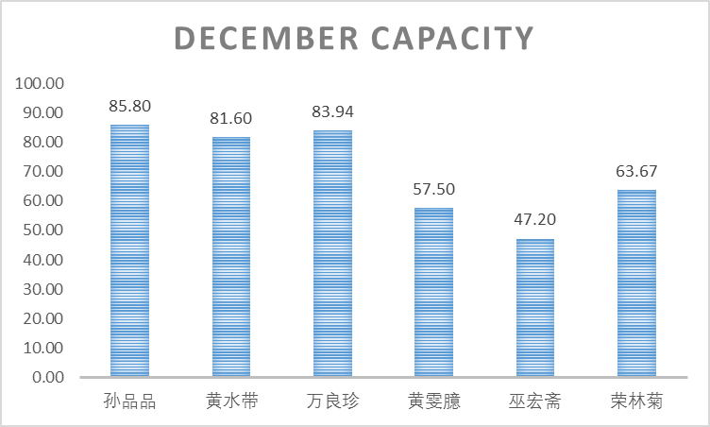
Analyze Current State Process – FLOW

Slide 29
Waste Review
Intellect
Rework
Any failure to fully utilize the time and talents of people
Any repair or rework
Inventory
Motion
Any more than the minimum to get the job done
Any motion of the worker that does not add value
Processing
Over-processing
Process Variability

Slide 30
IMPROVE Phase

Slide 31
Improve Process – PULL
Eliminate the non-value added steps which is repetition
Reduce the use frequency of microscope to ease eye strain

Slide 32
Improve Process – PULL
The time saved (glass tube) : (4.93+1.14)/29.03*100%=20.91%

Slide 33
Improve Process – PULL
The time saved (metal tube) : (4.48+1.07)/31.76*100%=17.47%

Slide 34
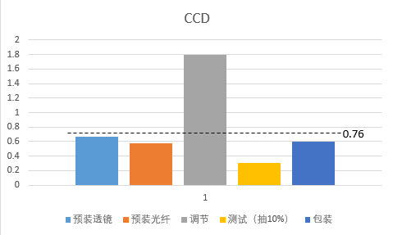
Run New Process
Current loading chart

Slide 35
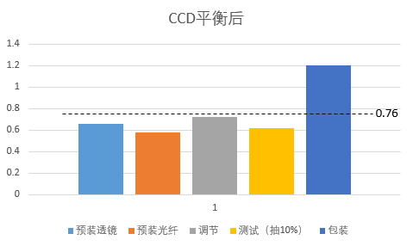
Run New Process
Future loading chart

Slide 36
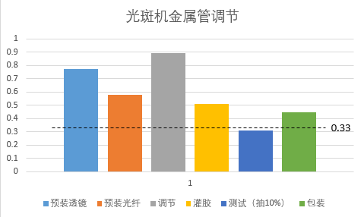
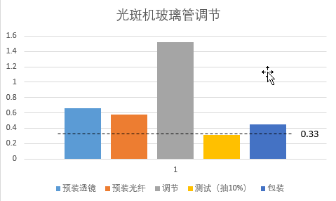
Run New Process
Current loading chart

Slide 37
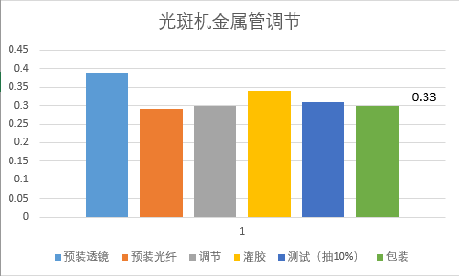
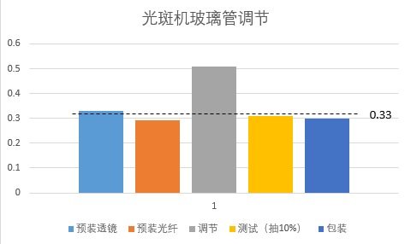
Run New Process
Future loading chart

Slide 38
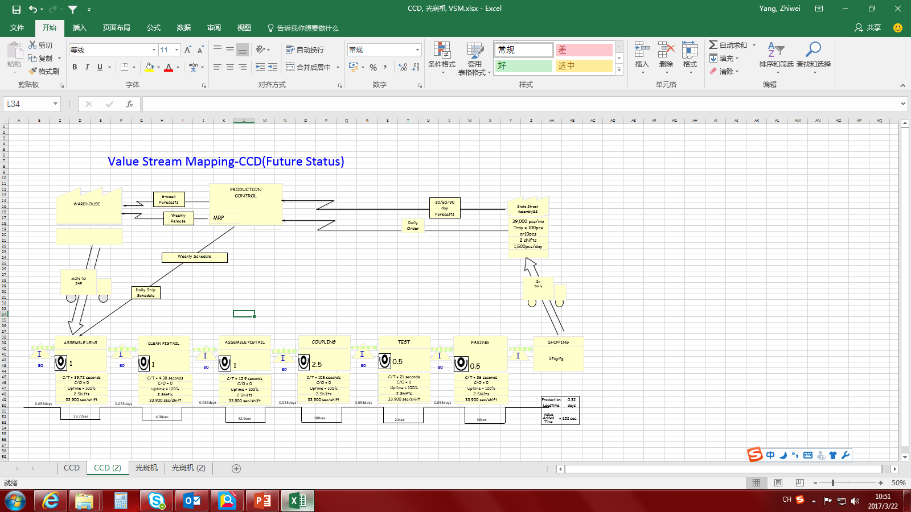
Future State VSM

Slide 39
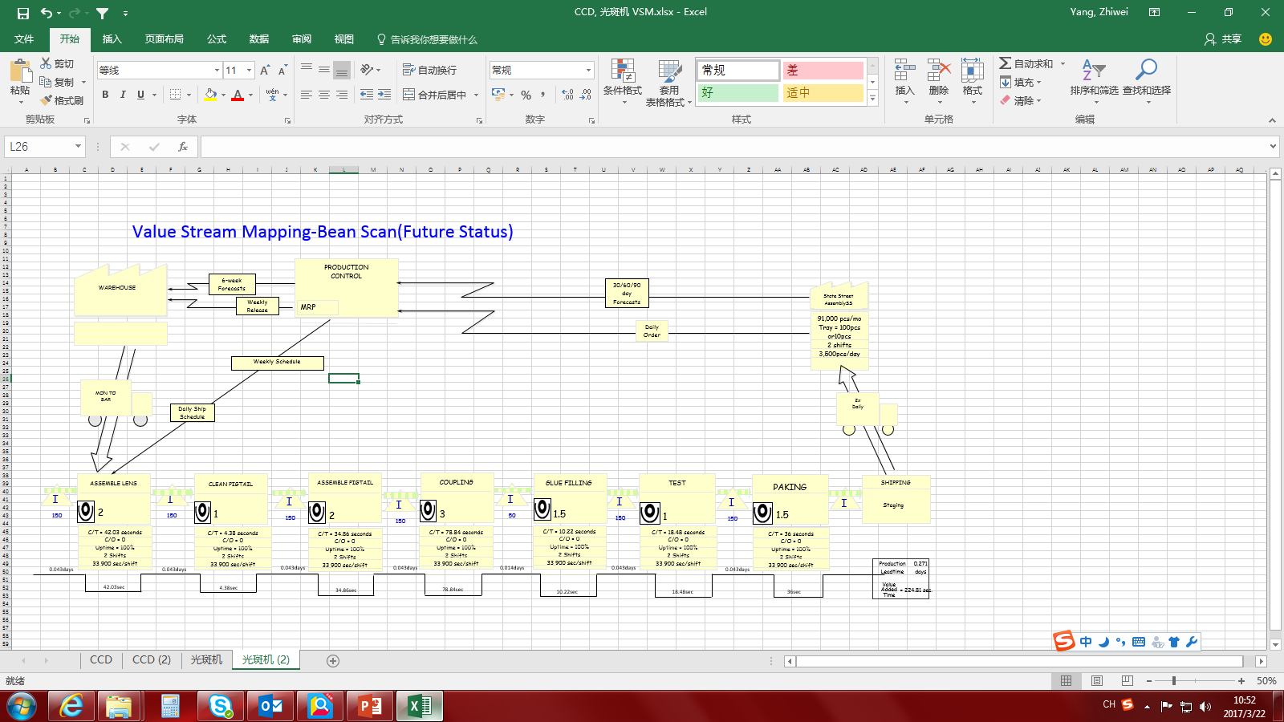
Future State VSM

Slide 40
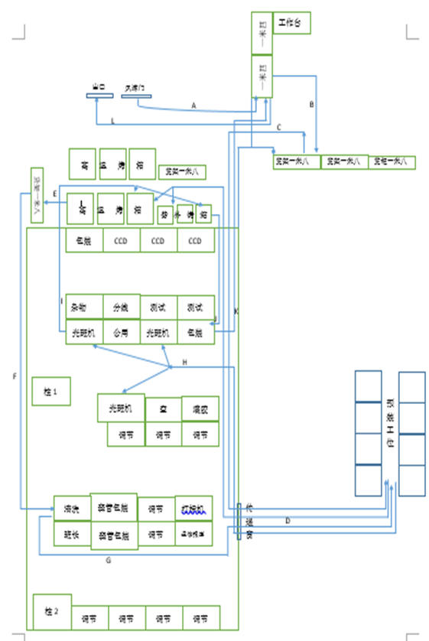
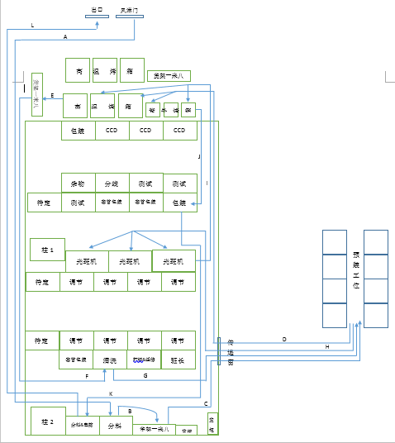
Spaghetti Diagram (After)

Slide 41
Implement 6S – S4-S6
S4 Standardize -Make some visual label to keep the workshop neat, clean and safety
S5 Self-Discipline(Sustain) -The operation must follow the Work Operation Instruction and continuous improvement
S6 Safety -The security view must through the other 5s activities

Slide 42
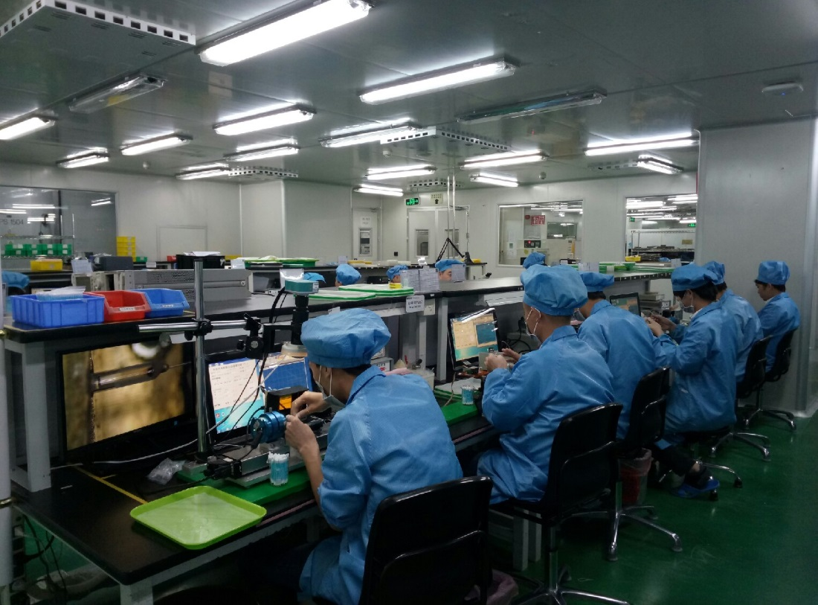
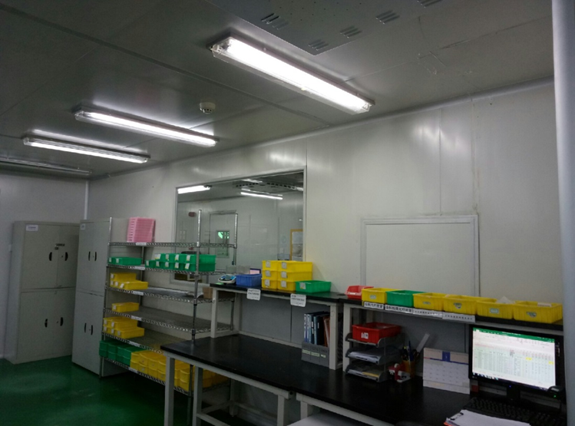
Implement 6S – S4-S6

Slide 43
CONTROL Phase

Slide 44
Create & Post SOP

Slide 45
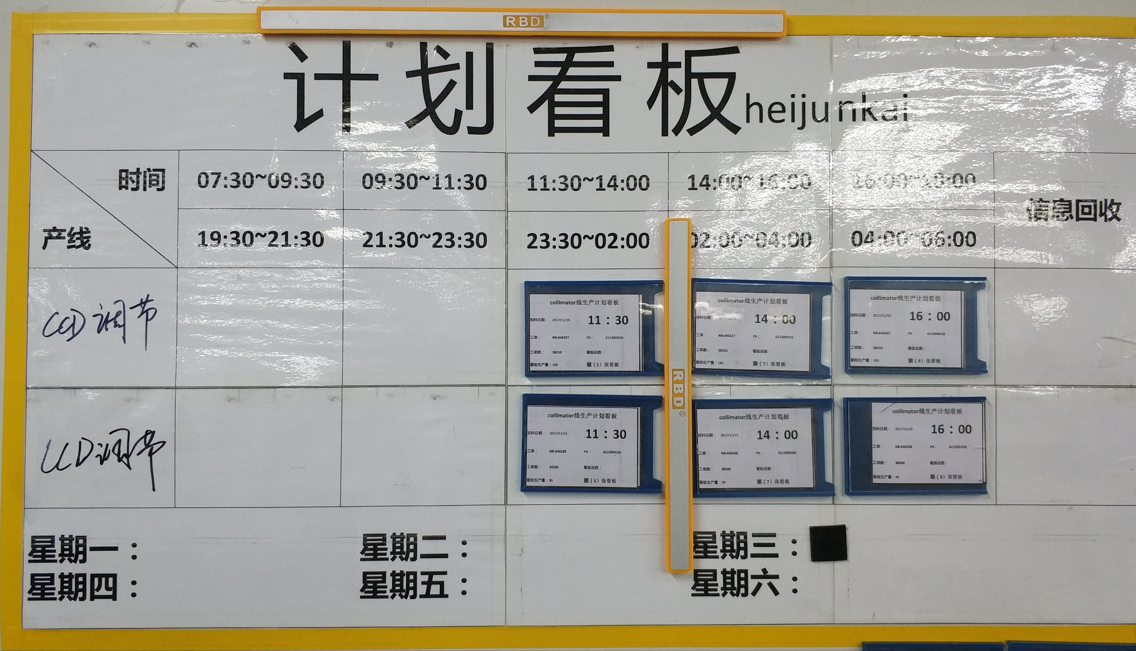
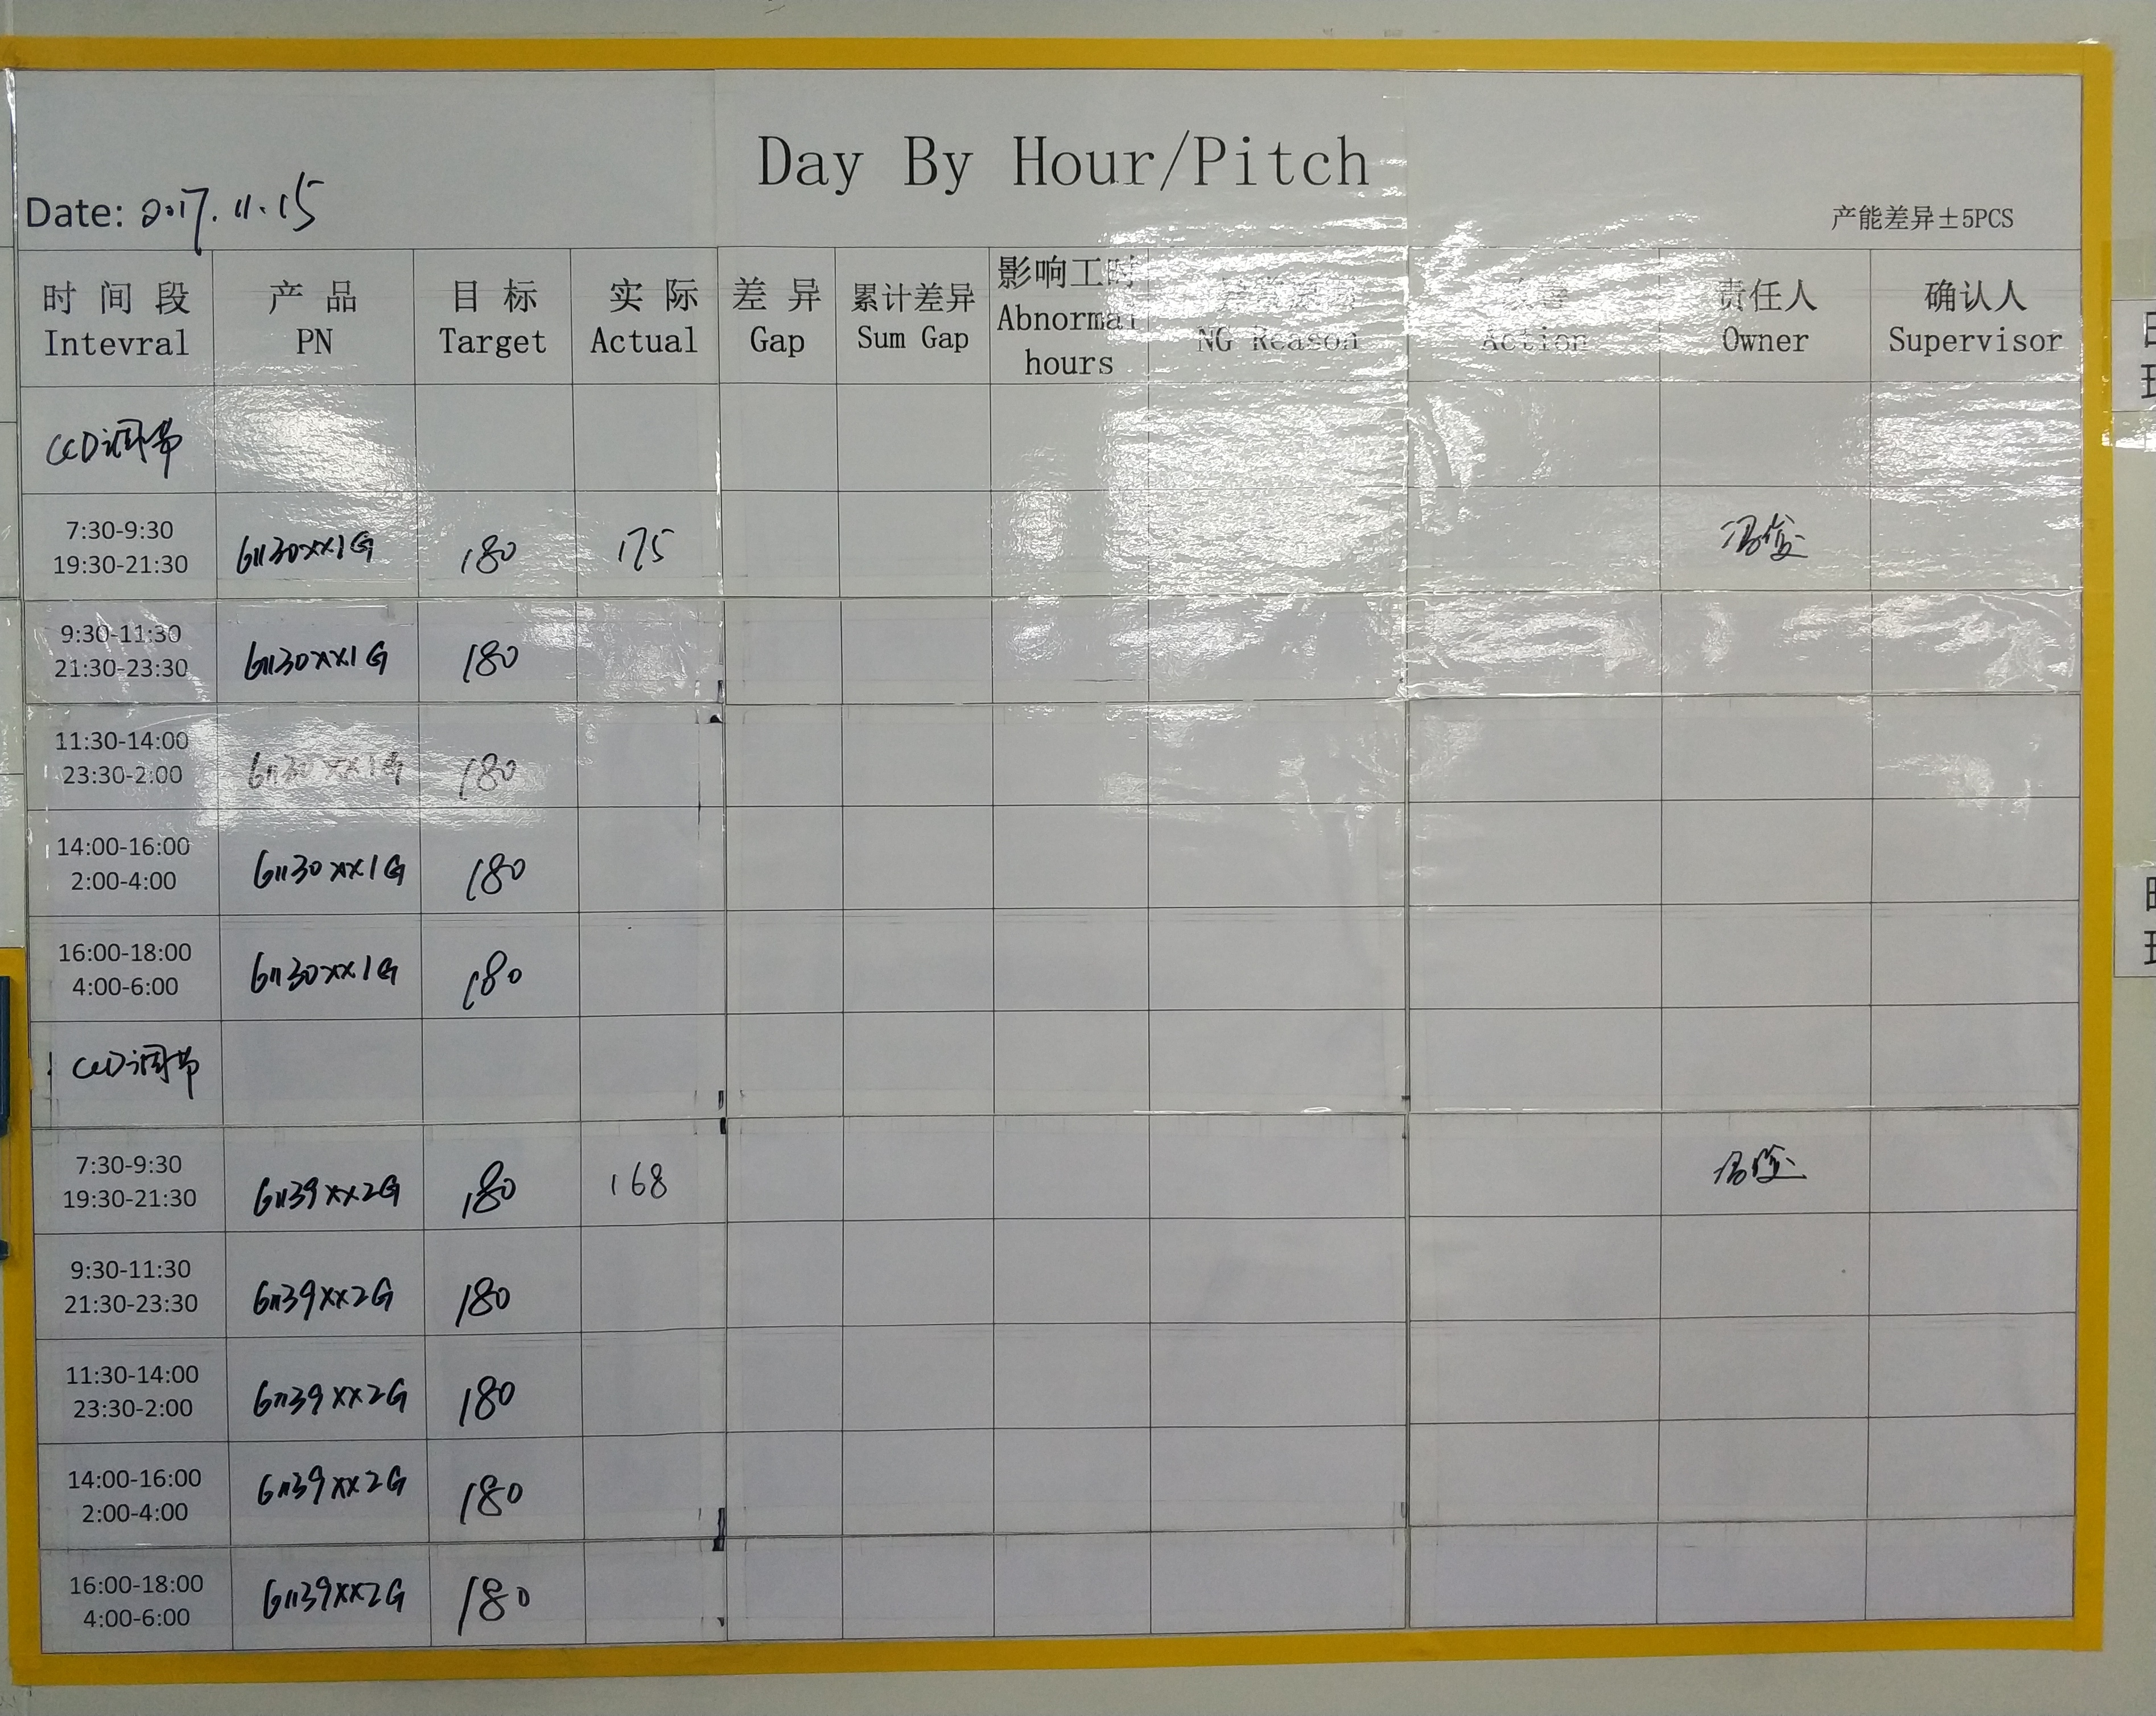
Process & Visual Controls

Slide 46
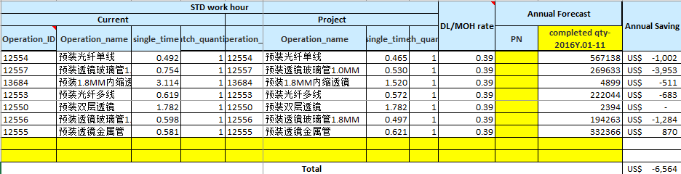
Updated Financial / FTE Benefit Forecast
Note: Financial and FTE Benefit Forecast should also be updated in the Project Benefit Summary area in PowerSteering.

Slide 47
To-Do List
Optimize the operation procedure and put the tools in fixed position aim to improve efficiency and capacity.
According to the Pitch adjust and optimize kiting mode.
Change the material turnover mode, ensure the quantity and the state is clearer.
Optimize the identification of non-conforming products.

Slide 48
Lessons Learned
The study of the assembly process is not enough, so we can not completely use the fixture.
There is not enough research and discussion in the engineering field, the increase of cleanliness requirement has an additional effect on the layout and material flow.

Slide 49
Executive Summary

Slide 50
Executive Summary
What was the problem? The capability of collimator is increase, but the assembly operation efficiency is low.
What did you improve? To optimize the procedure of assembly operation, cut down some useless action.
What were the results of the improvements?
Labor hour, BEFORE: 7.94min,
Labor hour, NOW: 5.99min
Reduce: (7.94-5.99)/7.94*100%=24.60%

Slide 51
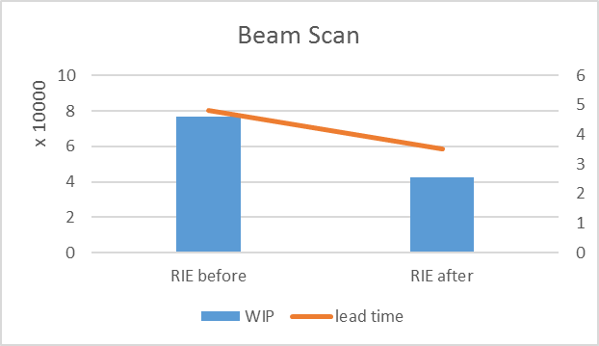
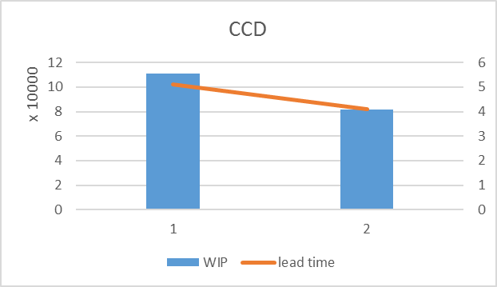
Executive Summary

Slide 52
项目心得
DMAIC的思维模式，帮助理清项目推进过程中的思路，避免思维片面性；
Lean工具的运用在项目中的作用，帮助大家利用数据将问题清晰的呈现出来；
对收益的思考及改善行动的持续跟踪。

